Slide 1
創意程式設計-感測器
-如何加入Sensor 控制程式至主程式內

Slide 2
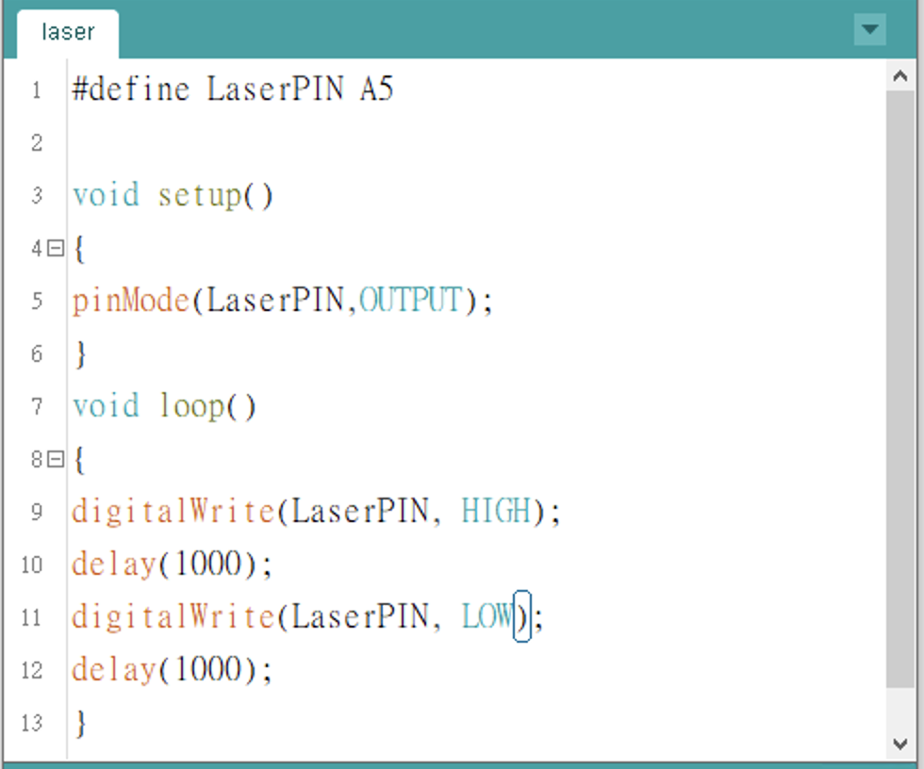
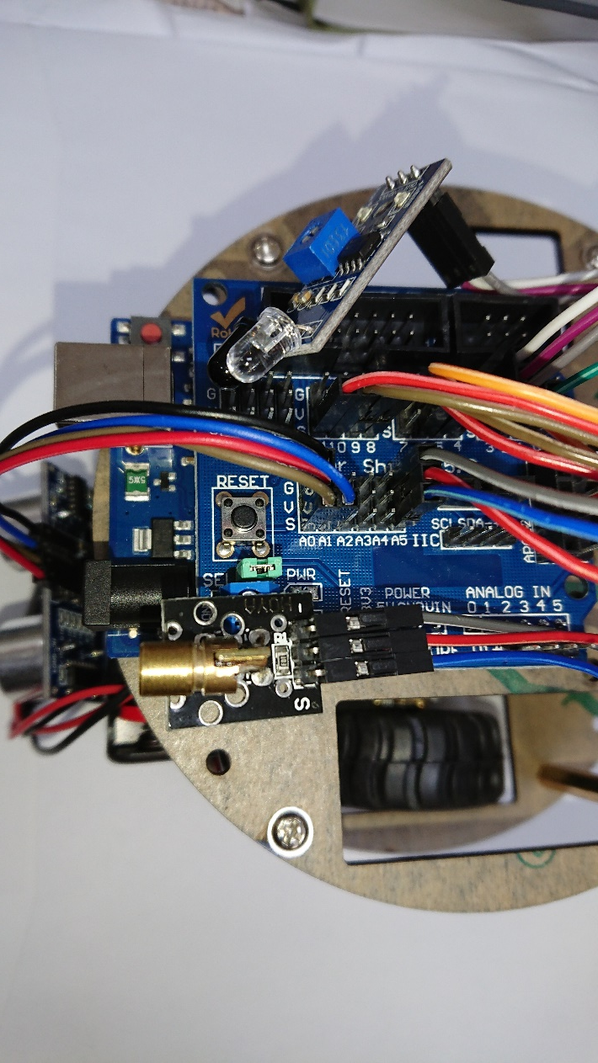
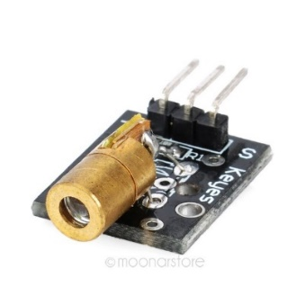
Laser-Gun (any PIN A0-A5 )
Laser Gun: When triggered, fire a laser beam.
pinMode(pin, OUTPUT) : the S pin should be set to OUTPUT mode.
digitalWrite(pin, HIGH) : Fired
digitalWrite(pin, LOW) : Closed
G V S

Slide 3
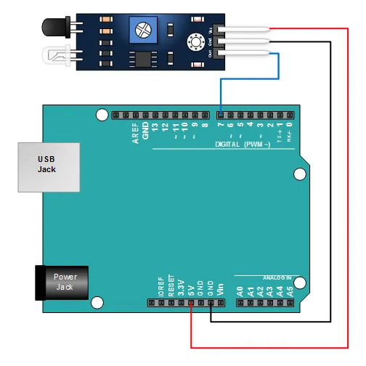
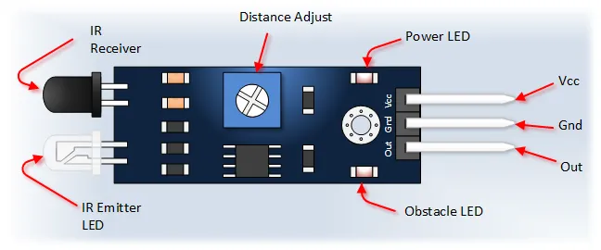
IR Obstacle Detection Module
Pin, Control Indicator | Description
Vcc | 3.3 to 5 Vdc Supply Input
Gnd | Ground Input
Out | Output that goes low when obstacle is in range
Power LED | Illuminates when power is applied
Obstacle LED | Illuminates when obstacle is detected
Distance Adjust | Adjust detection distance. CCW decreases distance. CW increases distance.
IR Emitter | Infrared emitter LED
IR Receiver | Infrared receiver that receives signal transmitted by Infrared emitter.

Slide 4
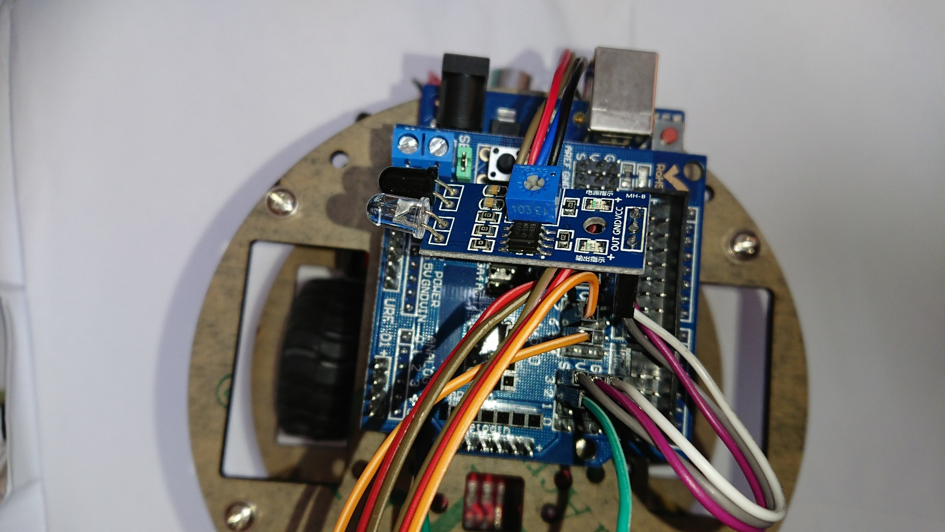
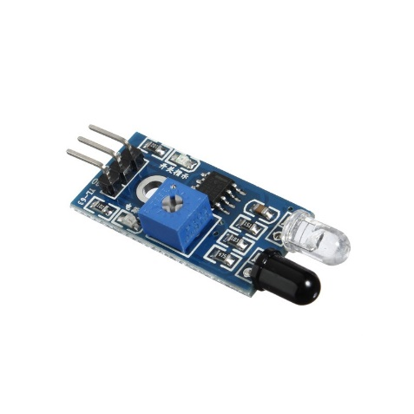
IR Obstacle Detection Module
注意 :
紅外線感測器OUT pin到pin 3 (s)，然後利用此程式測試。
螺絲順時中轉，偵測距離可變遠。(面積較大的物體較容易偵測到)

Slide 5
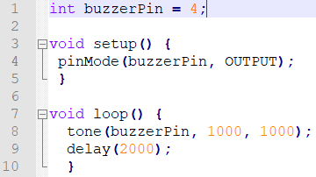
Buzzer(蜂鳴器)
蜂鳴器發聲原理 : 透過電流通過電磁線圈，使電磁線圈產生磁場驅動振動膜片發聲，本聲音是連續的類比訊號，數位系統無法發出類比訊號，但可以利用不同頻率的方波來發聲，如果對蜂鳴器施以週期性的方波，金屬片就會來回振動，只要方波週期在20Hz~20KHz，就會發出人耳聽的到的聲音。

Slide 6
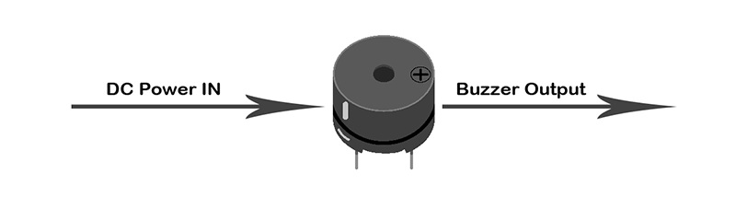
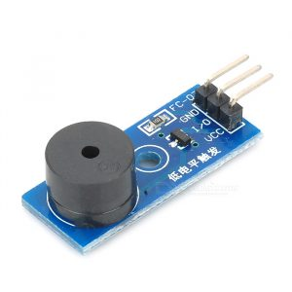
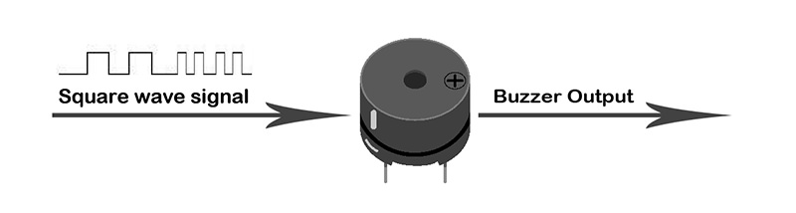
Buzzer (蜂鳴器)
Buzzers can be categorized into active and passive ones.
An active buzzer has a built-in oscillating circuits, so it will make sounds when electrified.
A passive buzzer does not have such oscillating circuits. It needs square waves with frequency between 2K and 5K to drive it to make sound. →Example

Slide 7
Buzzer (蜂鳴器)
The Arduino tone() function can generate a square wave of the specified frequency (and 50% duty cycle) on a pin, connected to a buzzer or speaker, to play tones.
tone(pin, frequency) ------------------------------> Example
tone(pin, frequency, duration) -----------------> Example1, Example2
A duration can be specified, otherwise the wave continues until a call to noTone().
Only one tone can be generated at a time. If a tone is already playing on a different pin, the call to tone() will have no effect. If the tone is playing on the same pin, the call will set its frequency.
NOTE:
Use of the tone() function will interfere with PWM output on pins 3 and 11 (on boards other than the Mega).
It is not possible to generate tones lower than 31Hz.

Slide 8
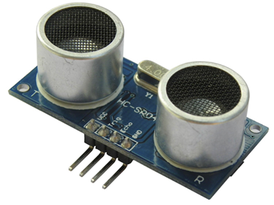
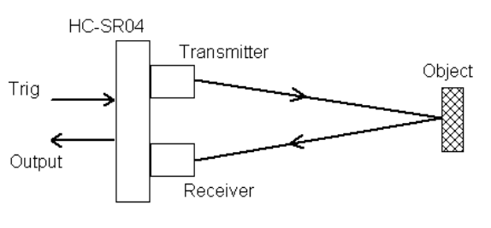
UltraSonic Sensor(Analog A0-A5)
超音波HC-SR04 : 由超音波發射器、接收器、控制電路所組成，當模組被觸發時會發射一連串40KHz的聲波並且從離它最近的物體接收回音。
原理 : 聲音在空氣中傳播速度大約是每秒340公尺，假設以340公尺計算，(毫秒10⁻³秒 微秒10⁻⁶秒)1000000 / 340 * 100 = 29.4 micro-second，可知傳播1公分所需時間為29微秒，由於超音波從發射到返回是兩段距離所以計算時必須除以2才是正確的物體距離。 ( timing(音波傳播時間) = 29.4 / 2 )
HC-SR04 Specifications
Working Voltage: DC 5V
Working Current: 15mA
Working Frequency: 40Hz
Max Range: 4m
Min Range: 2cm
Measuring Angle: 15 degree
Trigger Input Signal: 10µS TTL pulse
Echo Output Signal: Input TTL lever signal and the range in proportion
Dimension: 45 * 20 * 15mm

Slide 9
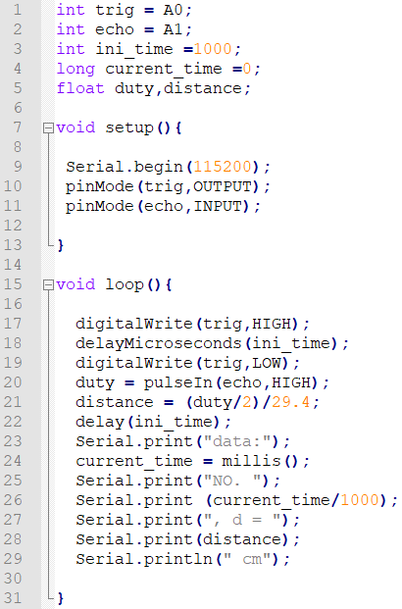
UltraSonic Arduino code
超音波程式 : 向trig腳位A0寫入一個高電位脈衝訊號來發射超音波，發射後模組在接收到迴音後，會將echo腳位A1升高為高電位，透過Arduino 系統提供之pulseIn函式可以測量echo腳位呈現高電位的時間(亦即超音波從發射到接收的時間)，並套用公式算出距離。
腳位 : A0:trig、A1:echo。
當Arduino UNO透過USB線連接至電腦時，loop()的執行結果可從 UNO 透過序列埠輸出函數(USB Serial.print())傳遞至電腦端Arduino IDE 的Serial Monitor上顯示資料。
先使用Serial.begin(115200) 初始化序列埠傳送訊息速率。
pinMode( ) : 設定腳位模式。(EX : (10) 設定trig腳位為OUTPUT狀態)
digitalWrite( ) : 輸出數位訊號。(EX : (17) 將trig腳位輸出為HIGH(高電位))
delayMicroseconds( ) : 延遲時間(微秒)。
pulseln ( ) : 讀取所指定之針腳改變狀態(HIGH或LOW)的脈衝時間(微秒)。

Slide 10
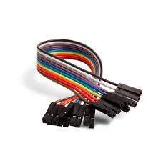
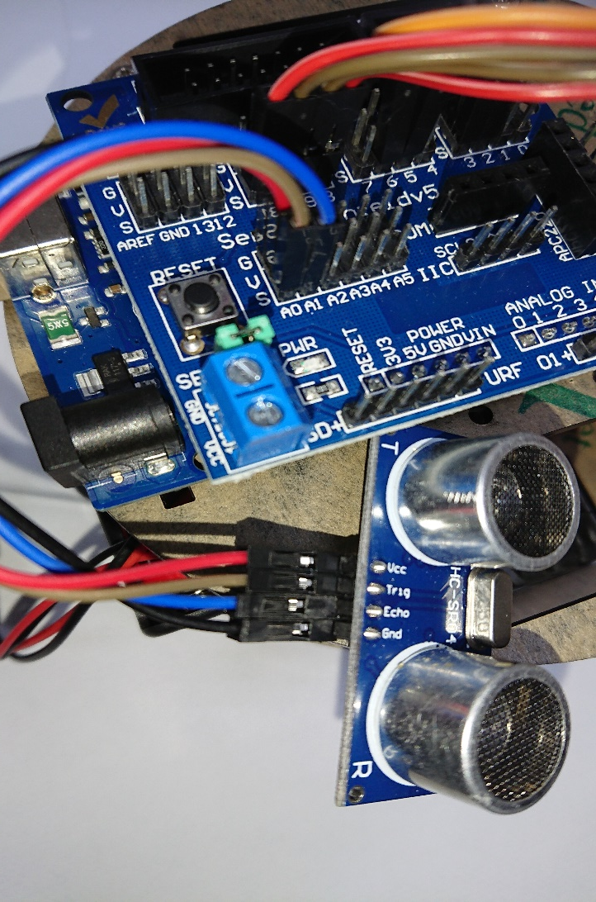
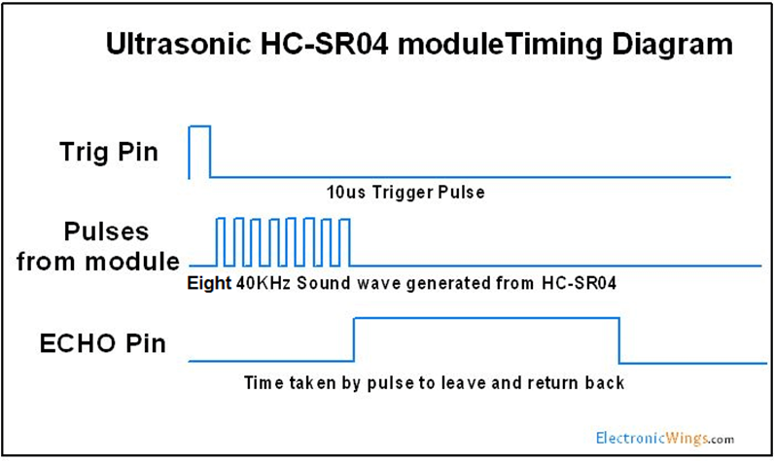

Test of the sensors’ Arduino code
使用Arduino UNO + 超音波模組 + 杜邦線。記住A0接trig、A1接echo ，才可使用下程式。(當然你也可以同時改程式和接線位置)
First example: Ultrasonic distance
Second example: Ultrasonic + Motors
超音波避障模組連接A0、A1

Slide 11
Exercise – Stop the advance motors and fire the laser when obstacles detected
Stop the advancing robot when obstacles are found within the range of 15 cm.
Fire the laser, better with sound effects.
Code will be available in Moodle after due date.

